Slide 1
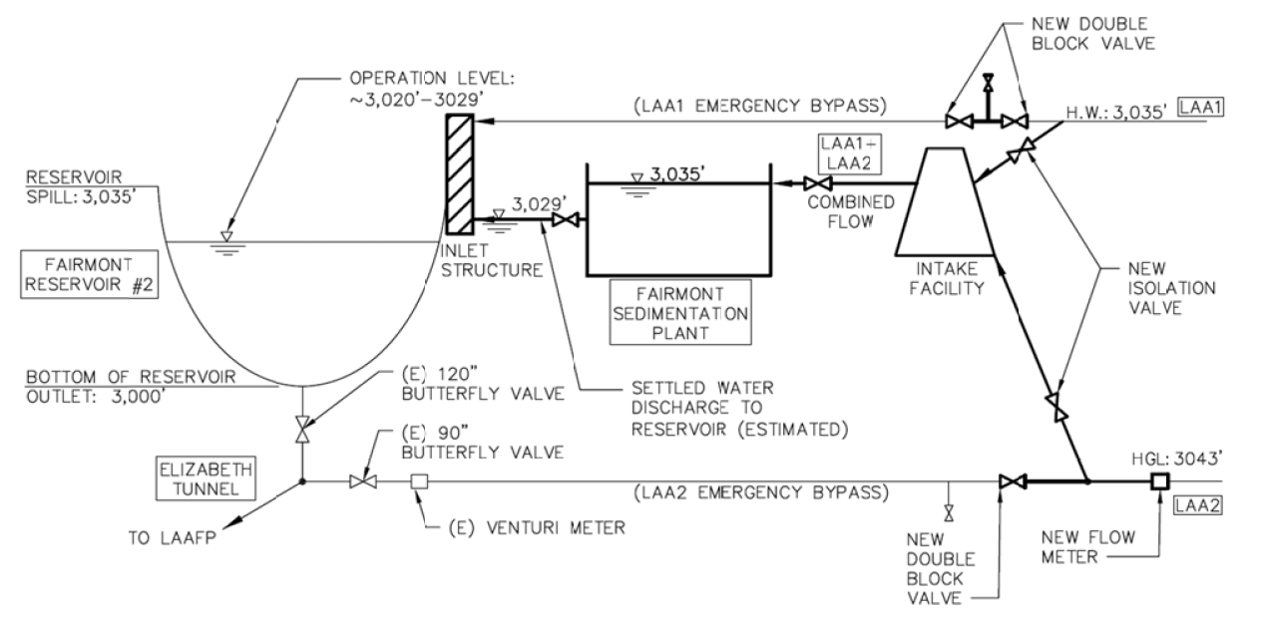
Our UP selection tool matters!

Slide 2
Rapid mix and Flocculation
FSP - Fairmont Sedimentation Plant
SOW – Scope of Work
LADWP - Los Angeles Department of Water and Power
BODR – Basis of Design Report

Slide 3
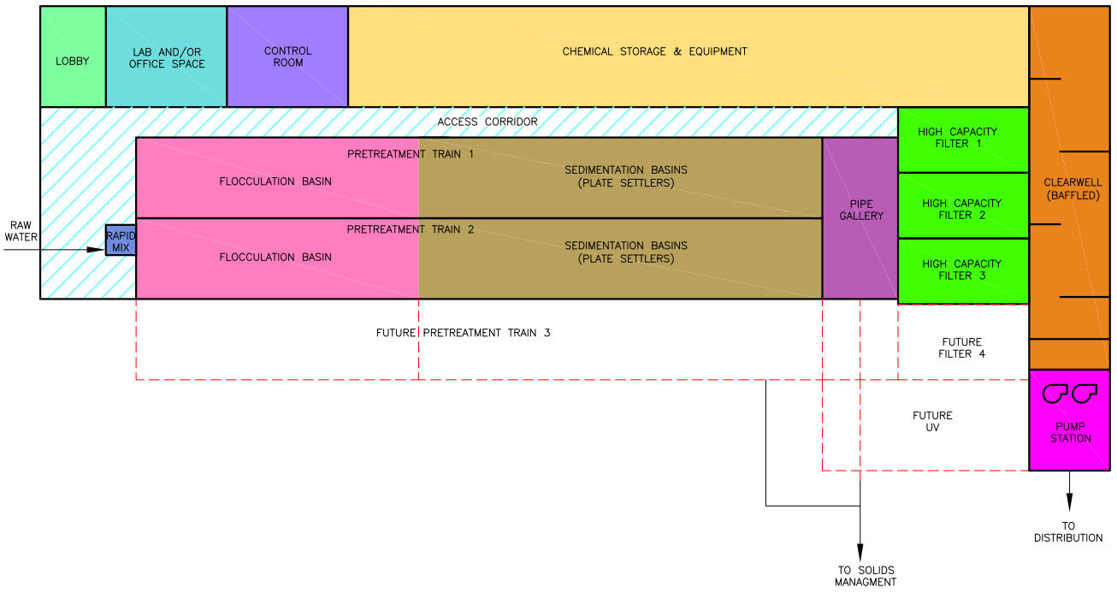
Rapid Mix: Smallest process, most energy in a conventional water treatment plant
https://www.townofbreckenridge.com/home/showdocument?id=7569
Notes:
https://www.townofbreckenridge.com/home/showdocument?id=7569

Slide 4
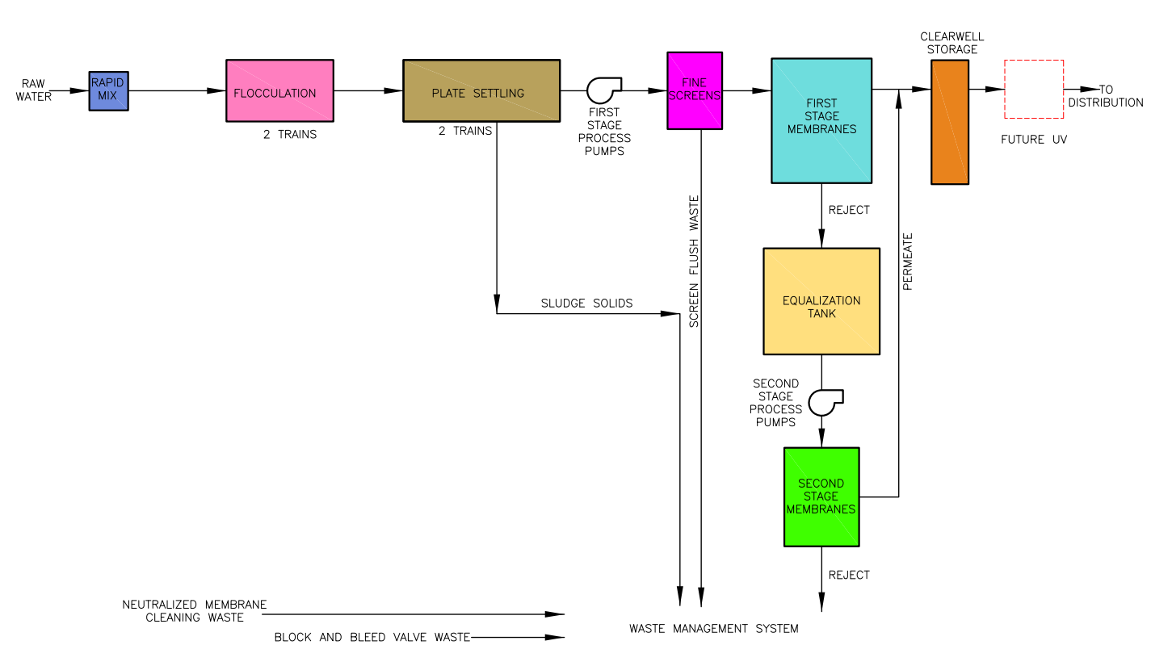
https://www.townofbreckenridge.com/home/showdocument?id=7569
Notes:
https://www.townofbreckenridge.com/home/showdocument?id=7569

